Slide 1
Claire Giordano
Wireframe
Europe
Asia
Africa
North America
South America
Australia
Antarctica

Slide 2

Once you click on the Continent of your choice… (For Example Asia)

Slide 3
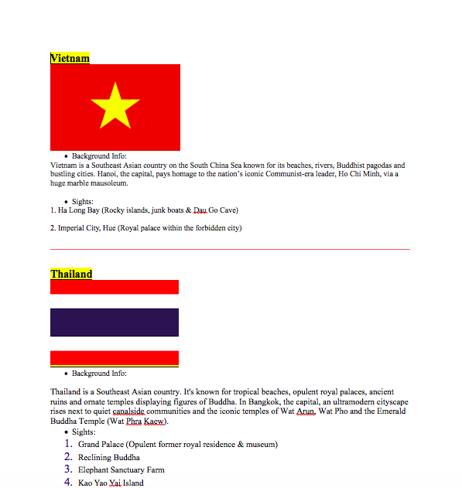
Next, when you make your choice, a page with personal pictures, google pictures, back ground information, and crucial sights will appear..
Use of Colors: I want the color scheme to be black and different shades of green (main page is going to be a globe)
Fonts: (bold font with glow effect and shadow effect)

Slide 4
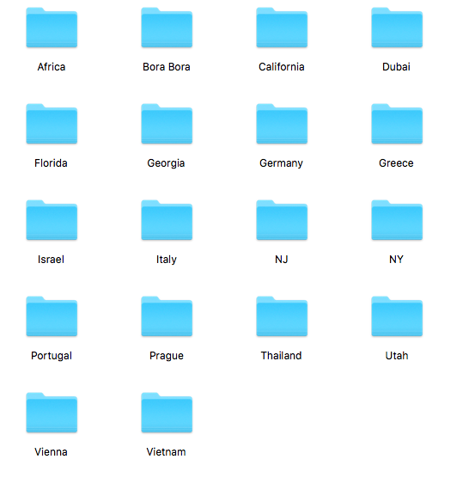
Places I’ll be showing

